Slide 1
Binary Search

Slide 2
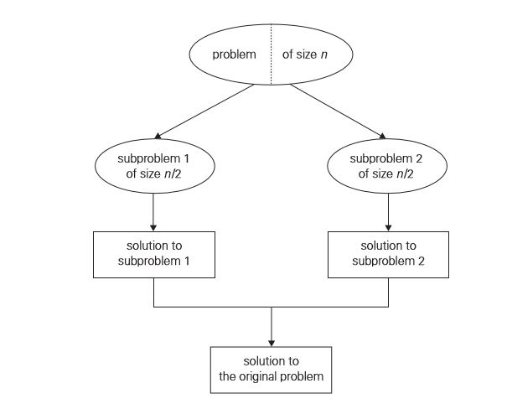
DIVIDE & CONQUER

Slide 3
DIVIDE & CONQUER
Divide a problem’s instance of size n into two instances of size n/2, till the division is possible or solution is found.
T (n)=aT (n/b)+f(n)
where f(n) is a function that accounts for the time spent on dividing an instance of size n into instances of size n/b and combining their solutions.
The order of growth of its solution T(n) depends on the values of the constants a and b and the order of growth of the function f(n).

Slide 4
Iterative (non recursive ) Algorithm
ALGORITHM: BinarySearch( A[0..n-1], K )
Input : An Sorted Array A[0..n-1], key element K
Output: Index of a n array element which matches with key element K
l=0; r=n-1;
While(l<=r) do
m=(l+r)/2
if ( k==A[m]) then
return m;
else if ( k<A[m]) then
r=m-1;
else
l=m+1;
endif
return -1
end while

Slide 5
Analysis
Input of an algorithm is an array of size n and key element k
Basic Operation of an algorithm is
if(k==A[m])
Execution of basic operation is depending on input values n and k
Best Case: If key elements happen to be the mid element
Cbest(n)=1
Worst Case: If key element happens to be first/last elements
or key element not found case
Cworst(n)= log2 n
Average Case : Caverage(n)< )= log2 n

Slide 6
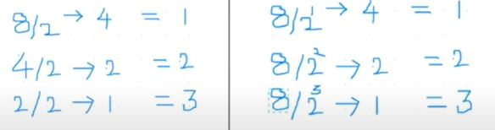
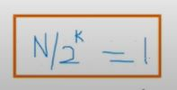
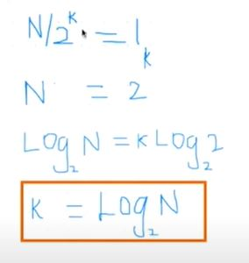
Analysis

Slide 7
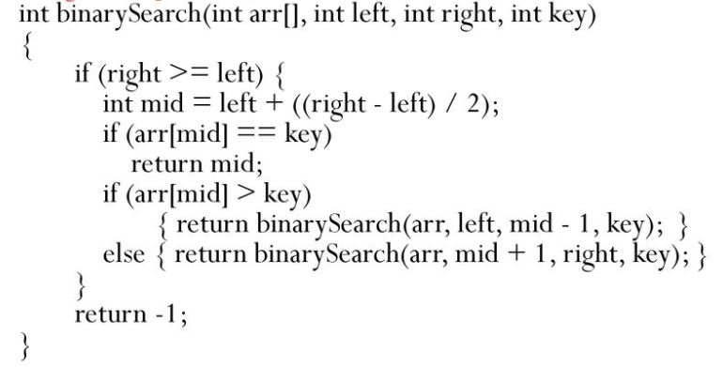
Recursive algorithm

